Slide 1
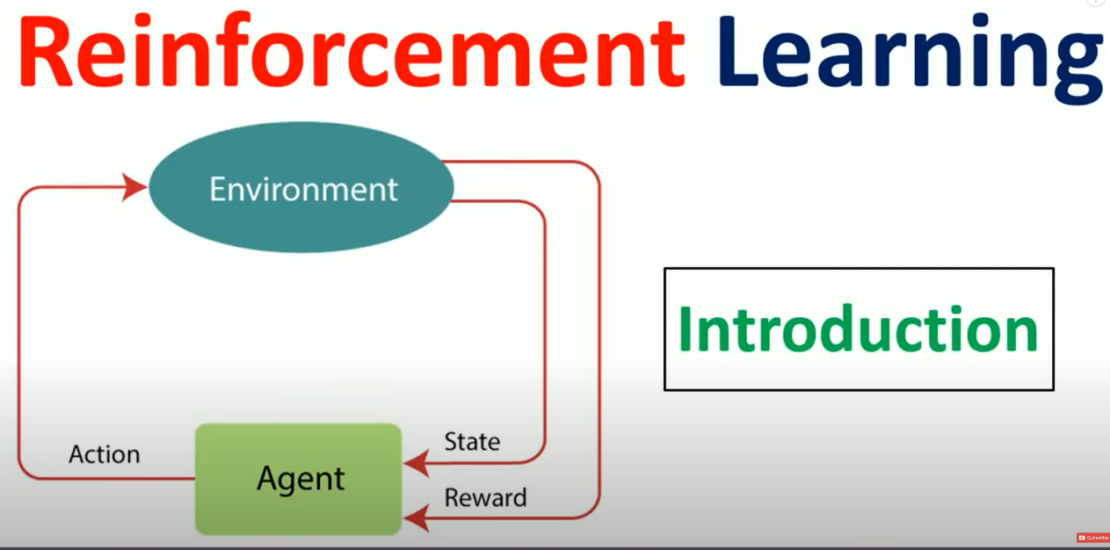

Slide 2
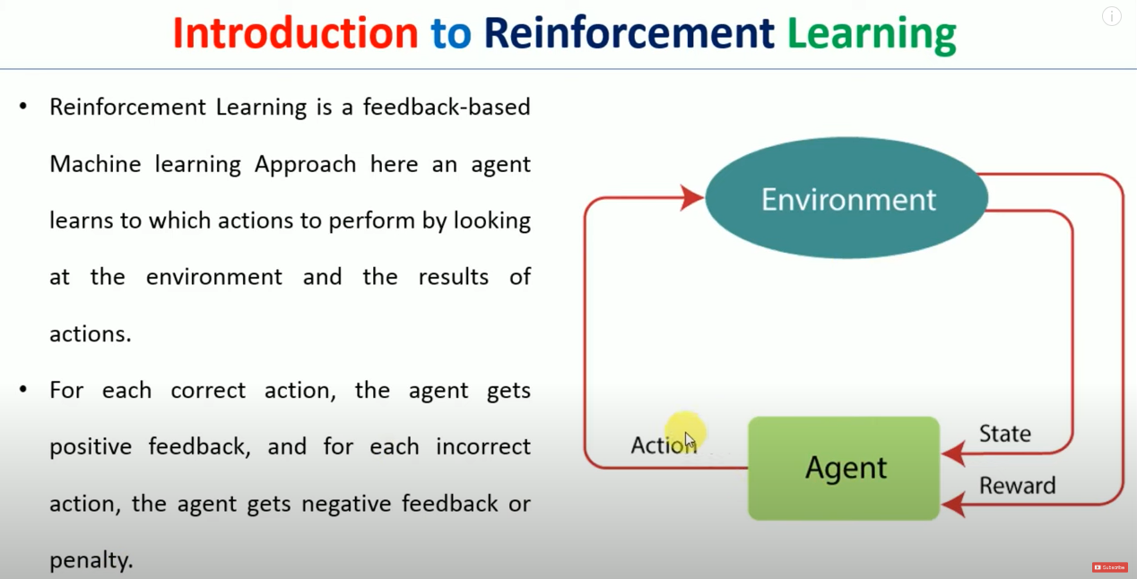

Slide 3
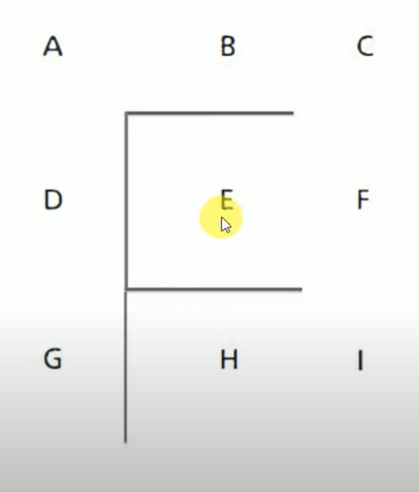

Slide 4
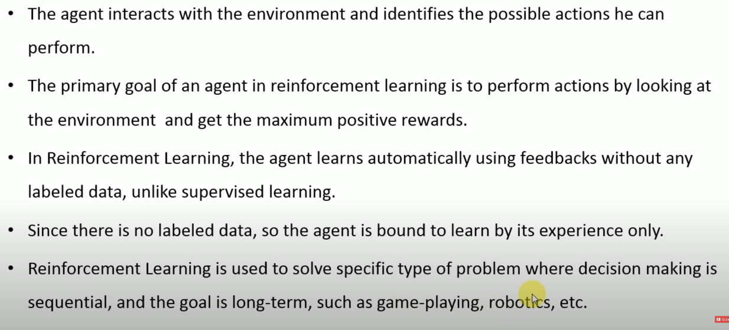

Slide 5
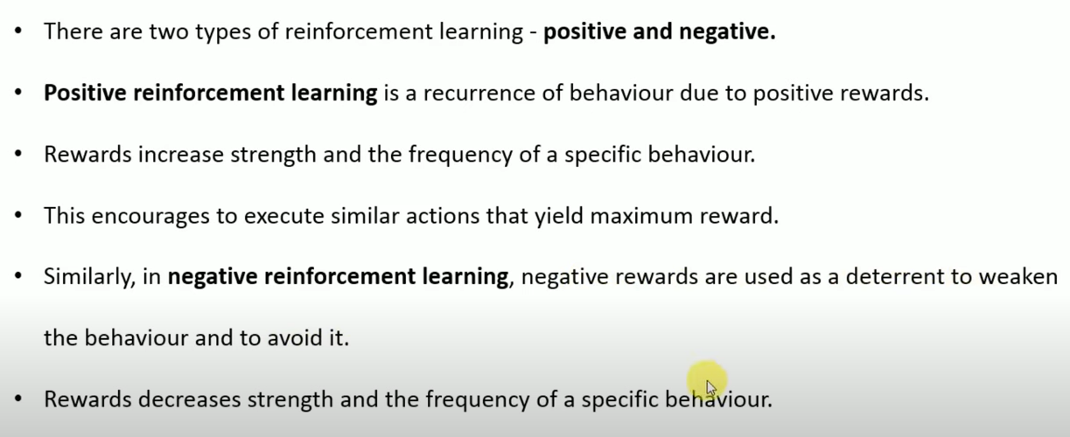

Slide 6
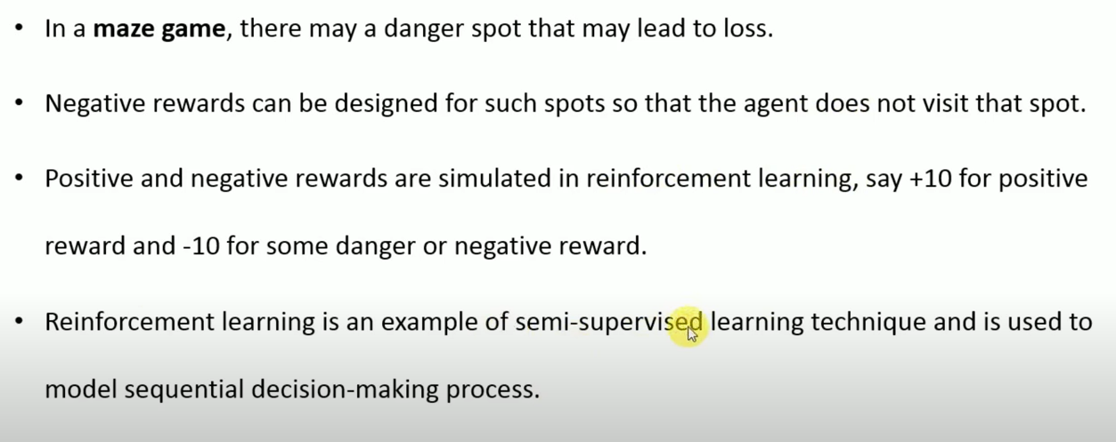

Slide 7
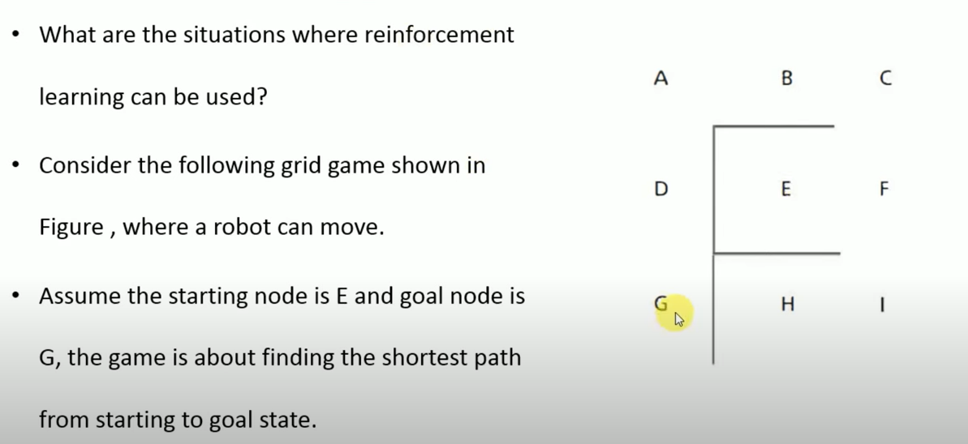

Slide 8
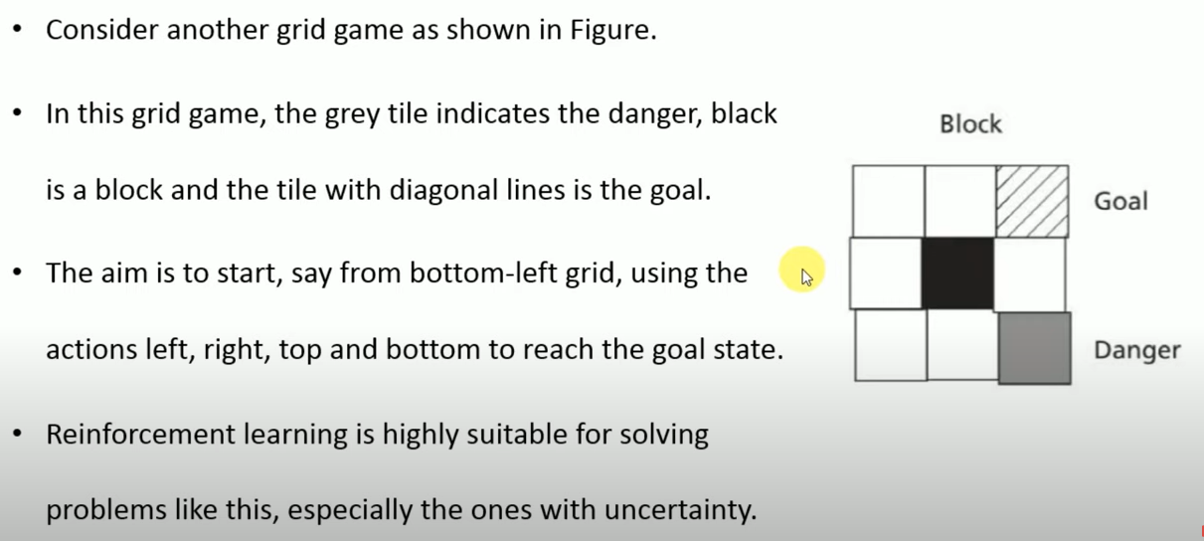

Slide 9
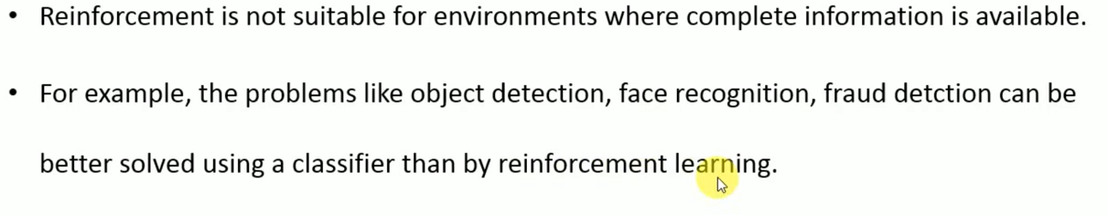

Slide 10
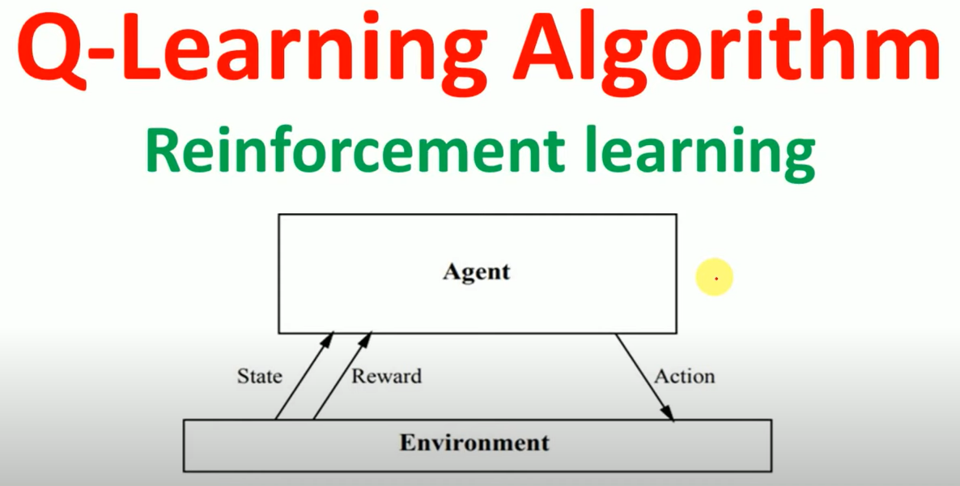

Slide 11
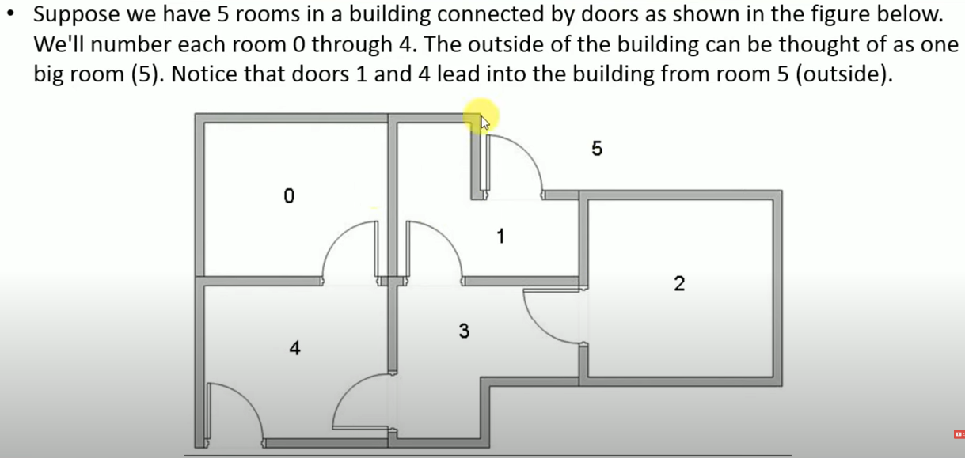

Slide 12
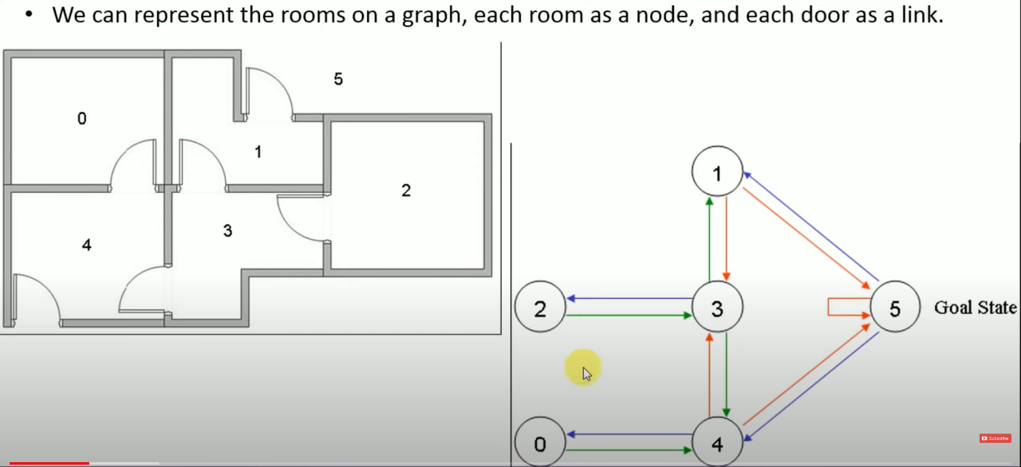

Slide 13
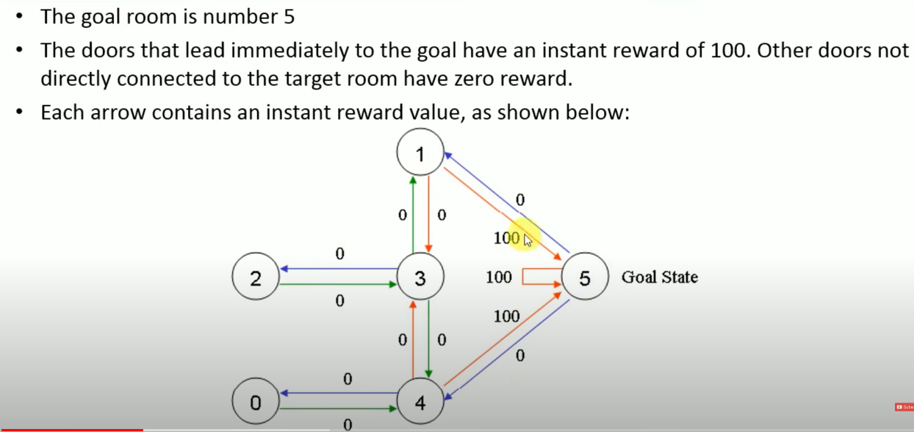

Slide 14
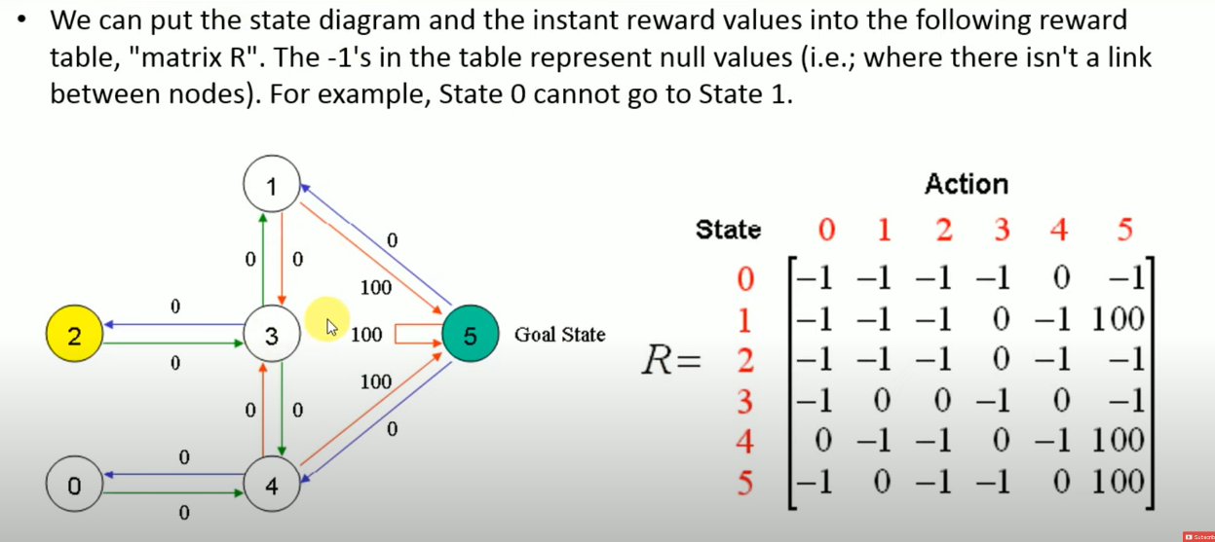

Slide 15
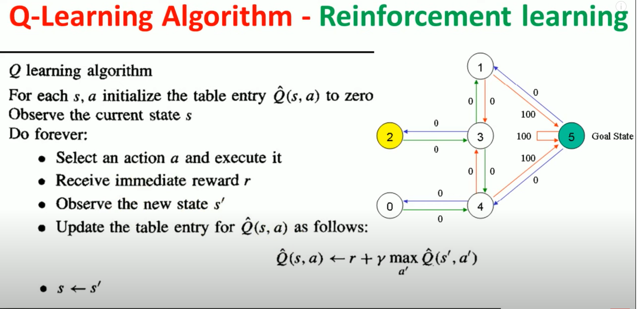

Slide 16
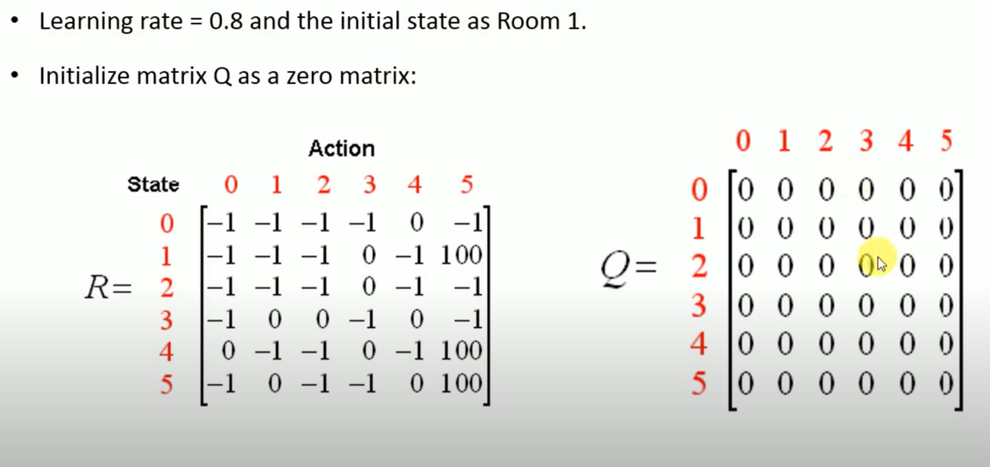

Slide 17
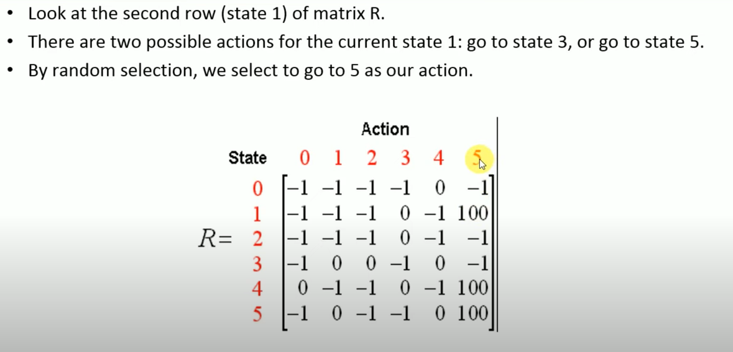

Slide 18
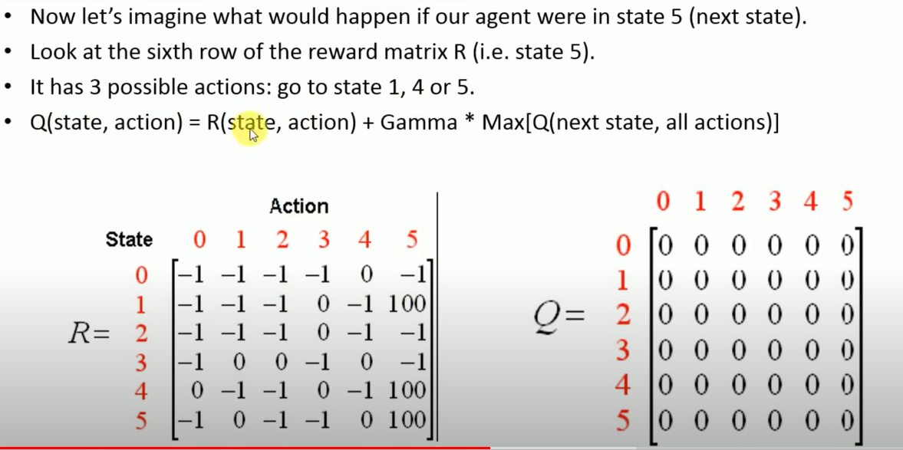

Slide 19
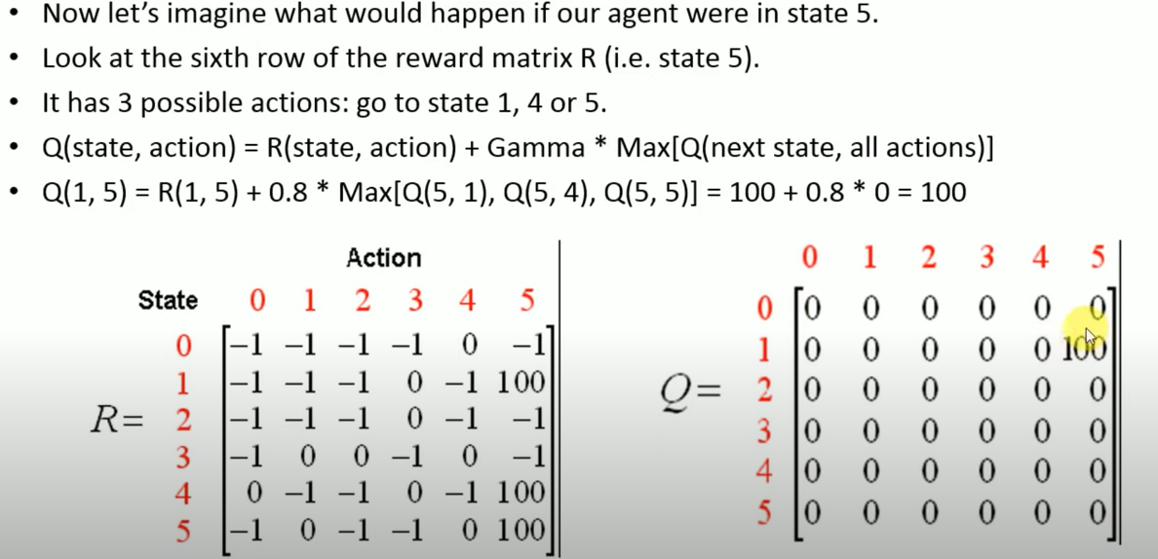

Slide 20
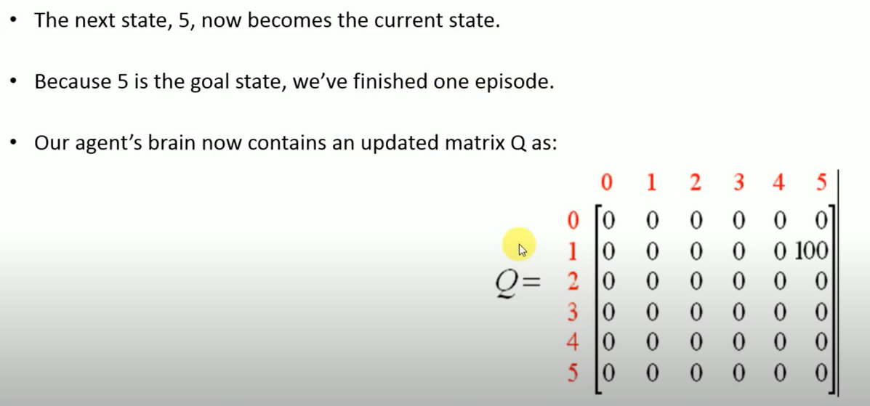

Slide 21
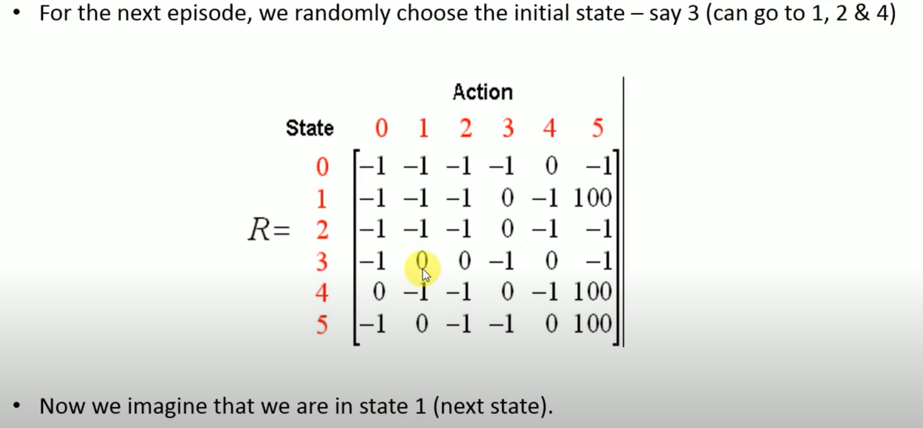

Slide 22
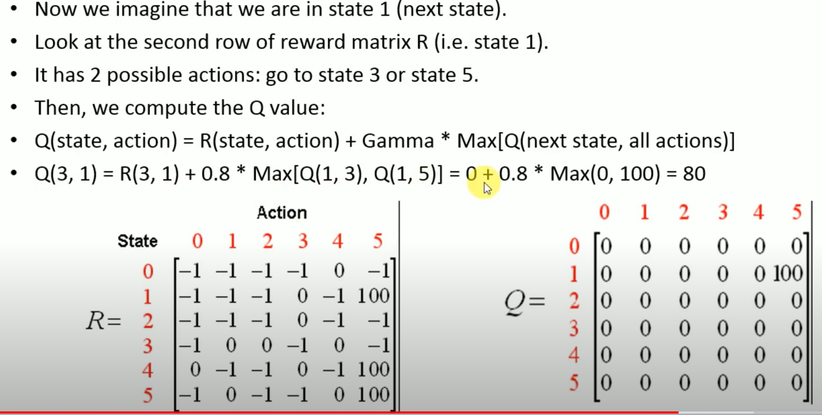

Slide 23
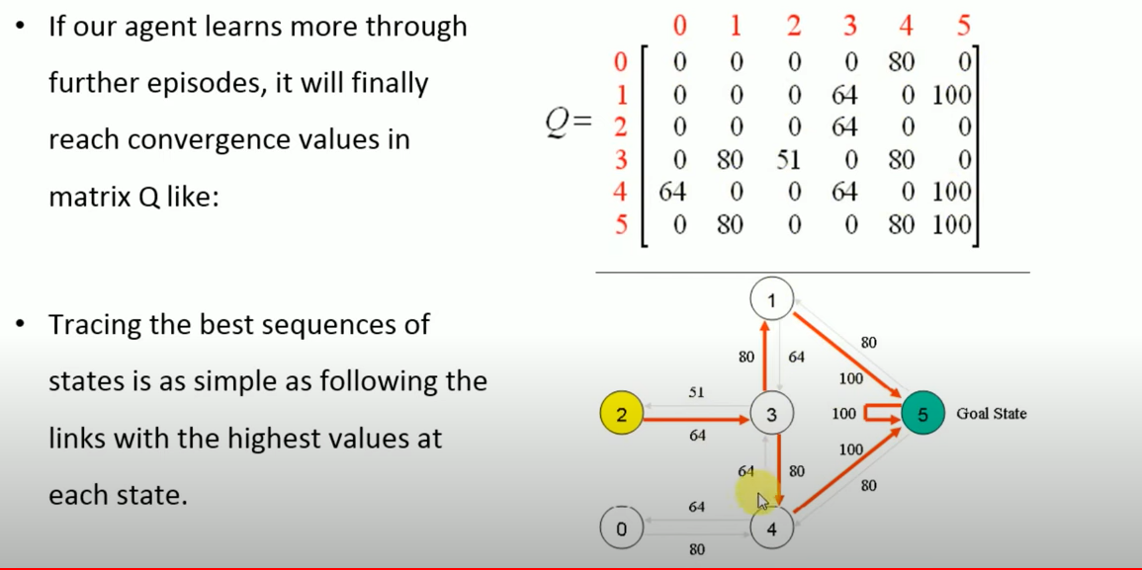

Slide 24
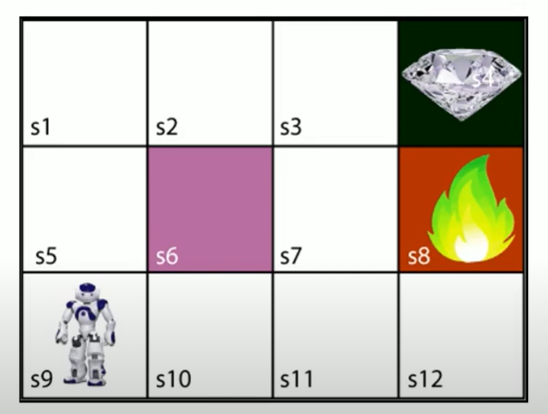

Slide 25
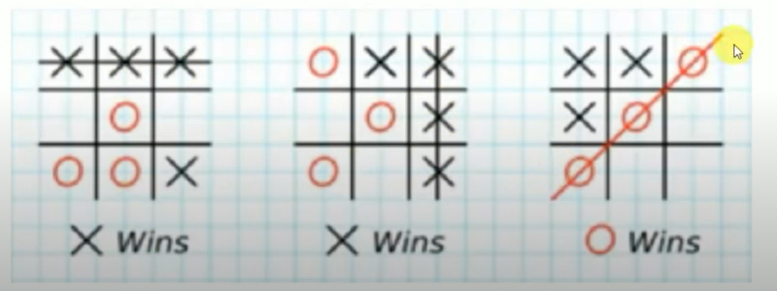

Slide 26
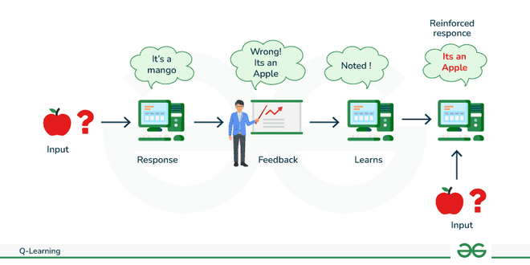

Slide 27
Agents: Entities that operate within an environment, making decisions and taking actions.
States: Variables that identify an agent’s current position in the environment.
Actions: Operations undertaken by the agent in specific states.
Rewards: Positive or negative responses provided to the agent based on its actions.
Episodes: Instances where an agent concludes its actions, marking the end of an episode.
Q-values: Metrics used to evaluate actions at specific states.
There are two methods for determining Q-values:
Temporal Difference: Calculated by comparing the current state and action values with the previous ones.
Bellman’s Equation: A recursive formula invented by Richard Bellman in 1957, used to calculate the value of a given state and determine its optimal position. It provides a recursive formula for calculating the value of a given state in a Markov Decision Process (MDP) and is particularly influential in the context of Q-learning and optimal decision-making.
The Equation is expressed as :
𝑄(𝑠,𝑎)=𝑅(𝑠,𝑎)+𝛾𝑚𝑎𝑥𝑎𝑄(𝑠’,𝑎)Q(s,a)=R(s,a)+γmaxa​Q(s’,a)
Where,
Q(s,a) is the Q-value for a given state-action pair
R(s,a) is the immediate reward for taking action a in state s.
gamma is the discount factor, representing the importance of future rewards.
max_{a}​Q(s′,a) is the maximum Q-value for the next state ′s′ and all possible actions.
Bellman’s equation is crucial in reinforcement learning as it helps in evaluating the long-term expected rewards associated with different actions in a given state. It forms the basis for Q-learning algorithms, guiding agents to learn optimal policies through iterative updates based on observed experiences.

Slide 28
The Q-table functions as a repository of rewards associated with optimal actions for each state in a given environment. It serves as a guide for the agent, indicating which actions are likely to yield positive outcomes in various scenarios.
Each row in the Q-table corresponds to a distinct situation the agent might face, while the columns represent the available actions. Through interactions with the environment and the receipt of rewards or penalties, the Q-table is dynamically updated to capture the model’s evolving understanding.
Reinforcement learning aims to enhance performance by refining the Q-table, enabling the agent to make informed decisions. As the Q-table undergoes continuous updates with more feedback, it becomes a more accurate resource, empowering the agent to make optimal choices and achieve superior results.
Crucially, the Q-table is closely tied to the Q-function, a mathematical expression that considers the current state and action, generating outputs that include anticipated future rewards for that specific state-action pair. By consulting the Q-table, the agent can retrieve expected future rewards, guiding it toward optimized decision-making and states.

Slide 29
Advantages:
Long-term outcomes, which are exceedingly challenging to accomplish, are best achieved with this strategy.
This learning paradigm closely resembles how people learn. Consequently, it is almost ideal.
The model has the ability to fix mistakes made during training.
Once a model has fixed a mistake, there is virtually little probability that it will happen again.
It can produce the ideal model to address a certain issue.
Disadvantages:
Drawback of using actual samples. Think about the situation of robot learning, for instance. The hardware for robots is typically quite expensive, subject to deterioration, and in need of meticulous upkeep. The expense of fixing a robot system is high.
Instead of abandoning reinforcement learning altogether, we can combine it with other techniques to alleviate many of its difficulties. Deep learning and reinforcement learning are one common combo.

Slide 30
Applications for Q-learning, a reinforcement learning algorithm, can be found in many different fields. Here are a few noteworthy instances:
Playing Games:
Atari Games: Classic Atari 2600 games can now be played with Q-learning. In games like Space Invaders and Breakout, Deep Q Networks (DQN), an extension of Q-learning that makes use of deep neural networks, has demonstrated superhuman performance.
Automation:
Robot Control: Q-learning is used in robotics to perform tasks like navigation and robot control. With Q-learning algorithms, robots can learn to navigate through environments, avoid obstacles, and maximise their movements.
Driverless Automobiles:
Traffic Management: Autonomous vehicle traffic management systems use Q-learning. It lessens congestion and enhances traffic flow overall by optimising route planning and traffic signal timings.
Finance:
Algorithmic Trading: The use of Q-learning to make trading decisions has been investigated in algorithmic trading. It makes it possible for automated agents to pick up the best strategies from past market data and adjust to shifting market conditions.
Health Care:
Personalized Treatment Plans: To make treatment plans more unique, Q-learning is used in the medical field. Through the use of patient data, agents are able to recommend personalized interventions that account for individual responses to various treatments.
Energy Management:
Smart Grids: Energy management systems for smart grids employ Q-learning. It aids in maximizing energy use, achieving supply and demand equilibrium, and enhancing the effectiveness of energy distribution.

Slide 31
Education:
Adaptive Learning Systems: Adaptive learning systems make use of Q-learning. These systems adjust the educational material and level of difficulty according to each student’s performance and learning style using Q-learning algorithms.
Recommendations Systems:
Content Recommendation: To customise content recommendations, recommendation systems use Q-learning. To increase user satisfaction, agents pick up on user preferences and modify recommendations accordingly.
Resources Management:
Network Resource Allocation: Allocating bandwidth in communication networks is one example of how network resource management uses Q-learning. It aids in resource allocation optimisation for improved network performance.
Space Travel:
Satellite Control: Autonomous satellite control is possible with Q-learning. Agents are trained in the best movements and activities for satellite operations in orbit.

